Slide 1

Python Data Structures

Slide 2
Objectives
Describe and manipulate tuple combinations and list data structures.
Execute basic tuple operations in Python.
Perform list operations in Python.
Some demonstration of using list and tuple
Python Data Structures

Slide 3
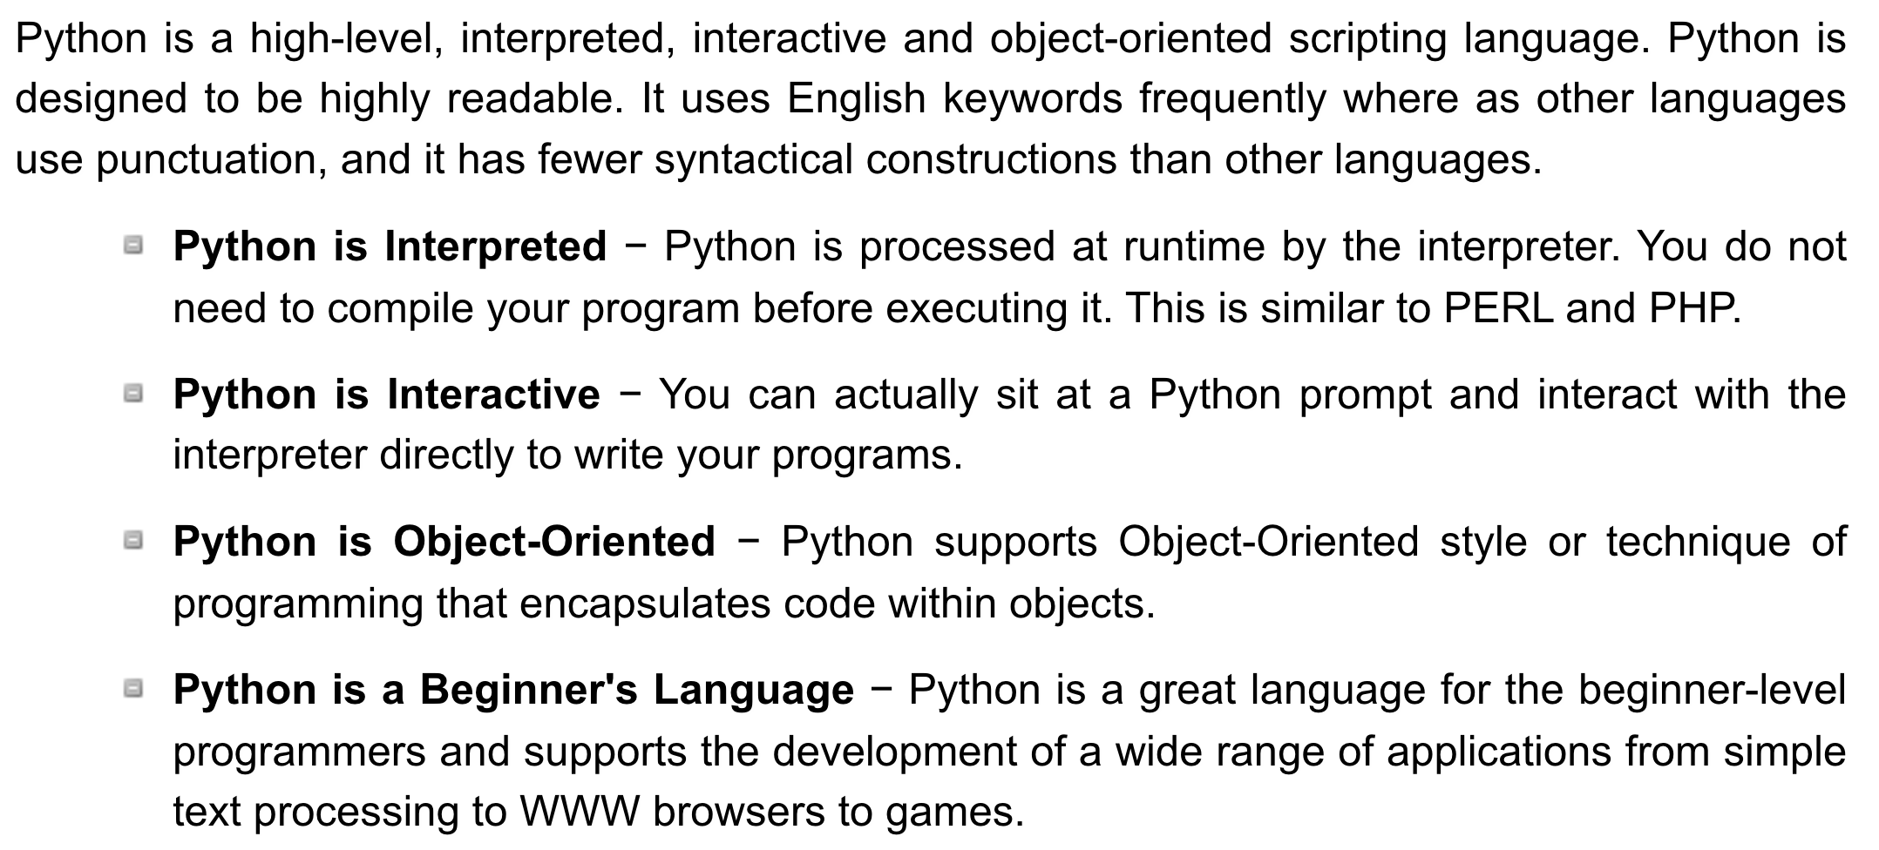
The Python Language
Python Data Structures
Notes:
Ngôn ngữ thông dịch (tiếng Anh: interpreted language) ﻿Python là một ngôn ngữ phiên dịch (Interpreter Language),
tức là không cần build thành file thực thi mà chạy trực tiếp
như PHP.

Slide 4
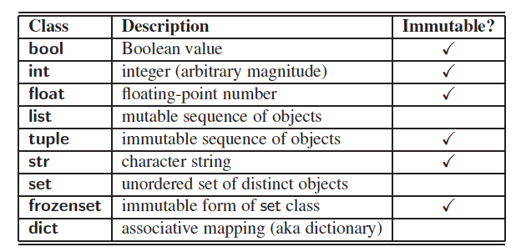
Built-In Classes
A class is immutable if each object of that class has a fixed value upon instantiation that cannot subsequently be changed. For example, the float class is immutable.
Python Data Structures

Slide 5
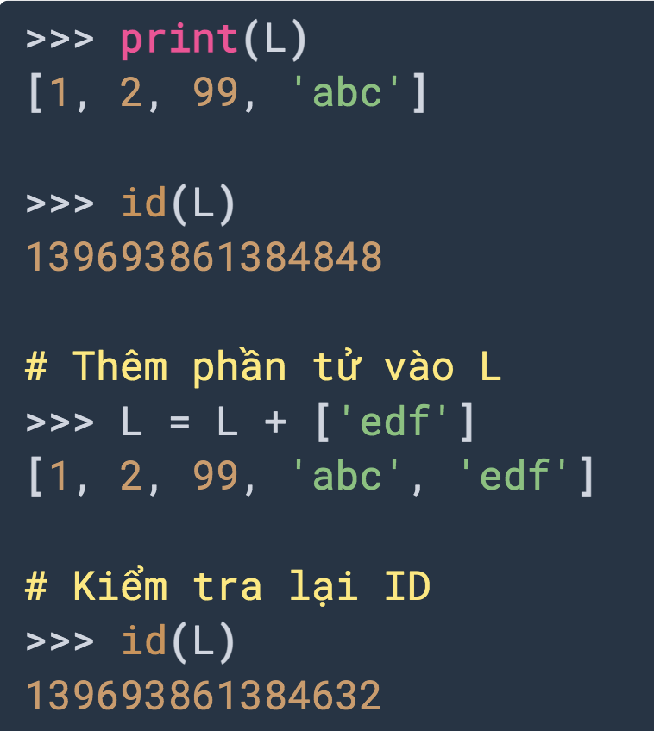
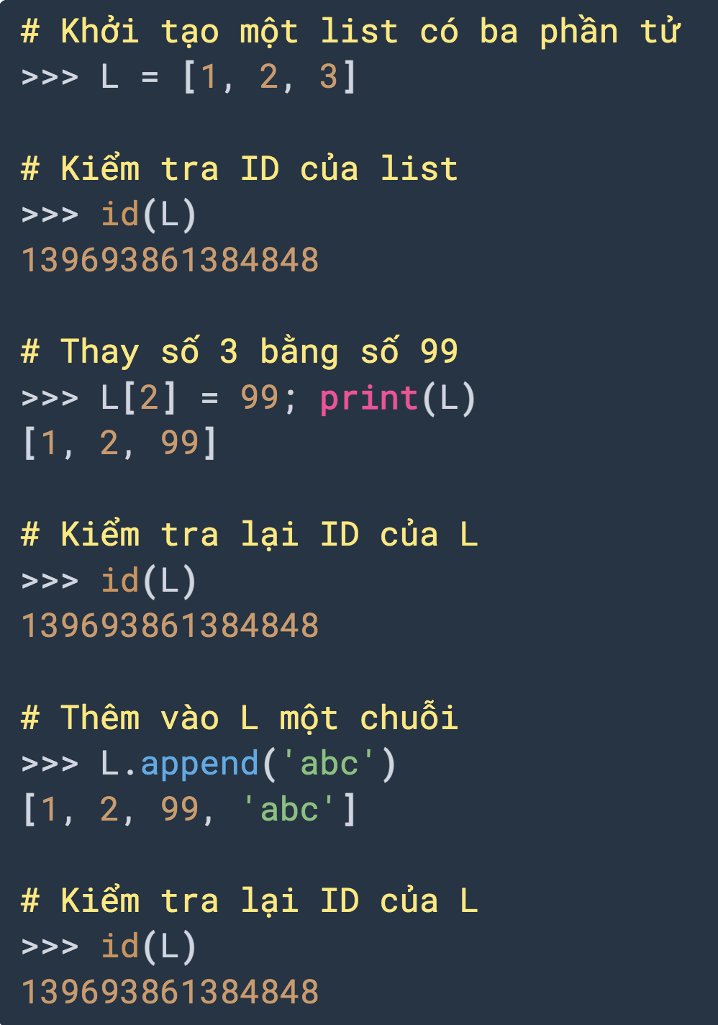
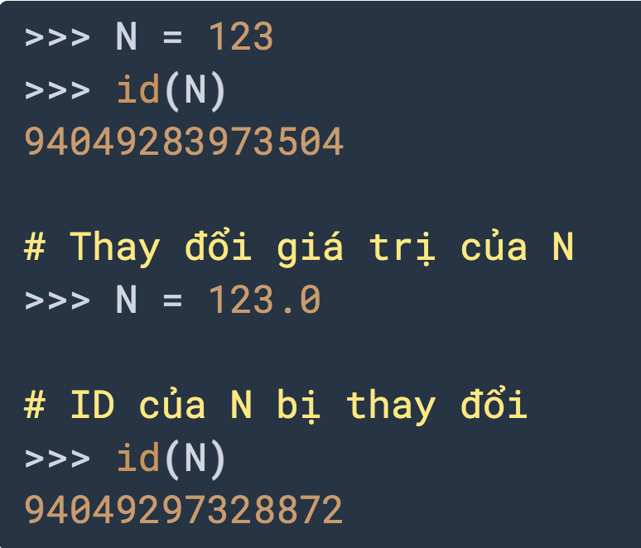
Built-In Classes
Mutable
Immutable
Python Data Structures

Slide 6
The list Class
A list instance stores a sequence of objects, that is, a sequence of references (or pointers) to objects in the list.
Elements of a list may be arbitrary objects (including the None object).
Lists are array-based sequences and a list of length n has elements indexed from 0 to n−1 inclusive.
Lists have the ability to dynamically expand and contract their capacities as needed.
Python uses the characters [ ] as delimiters for a list literal.
  [ ] is an empty list.
  [‘red’, ‘green’, ‘blue’] is a list containing three string instances.
The list( ) constructor produces an empty list by default.
The list constructor will accept any iterable parameter.
  list(‘hello’) produces a list of individual characters, [‘h’, ‘e’, ‘l’, ‘l’, ‘o’].
Python Data Structures

Slide 7
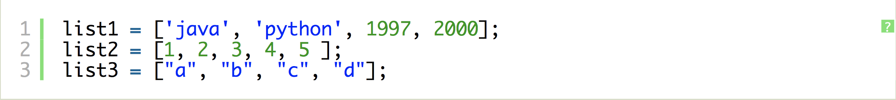
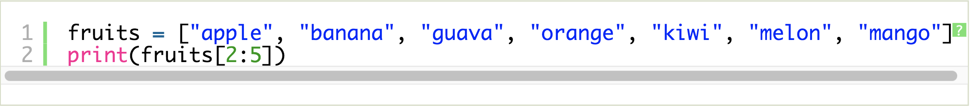
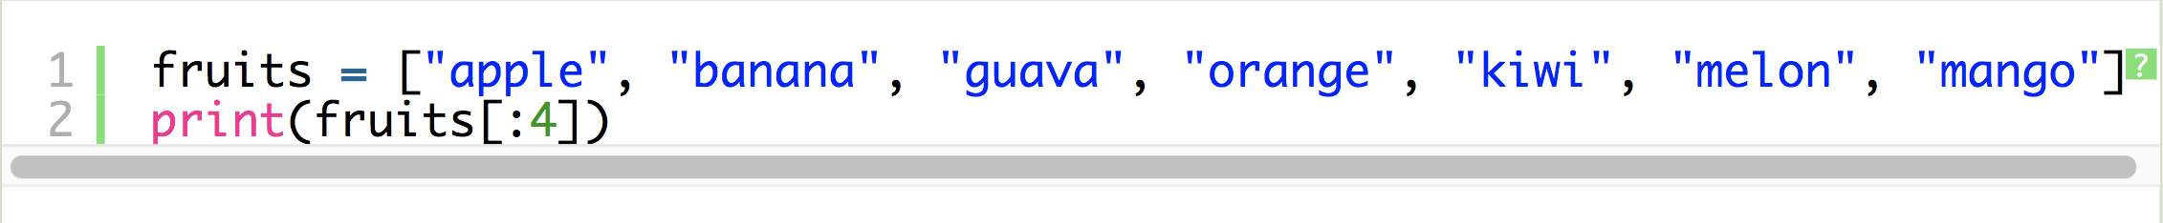
The list Class
Python Data Structures

Slide 8


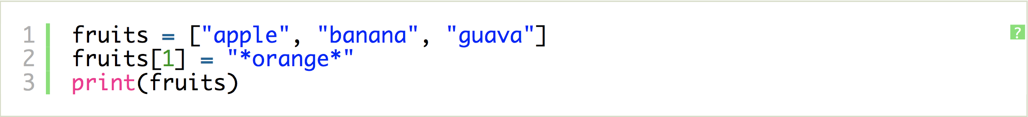
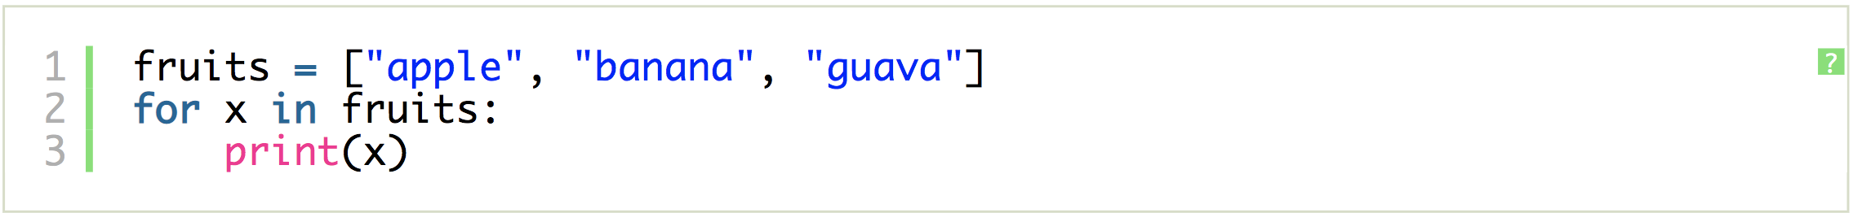
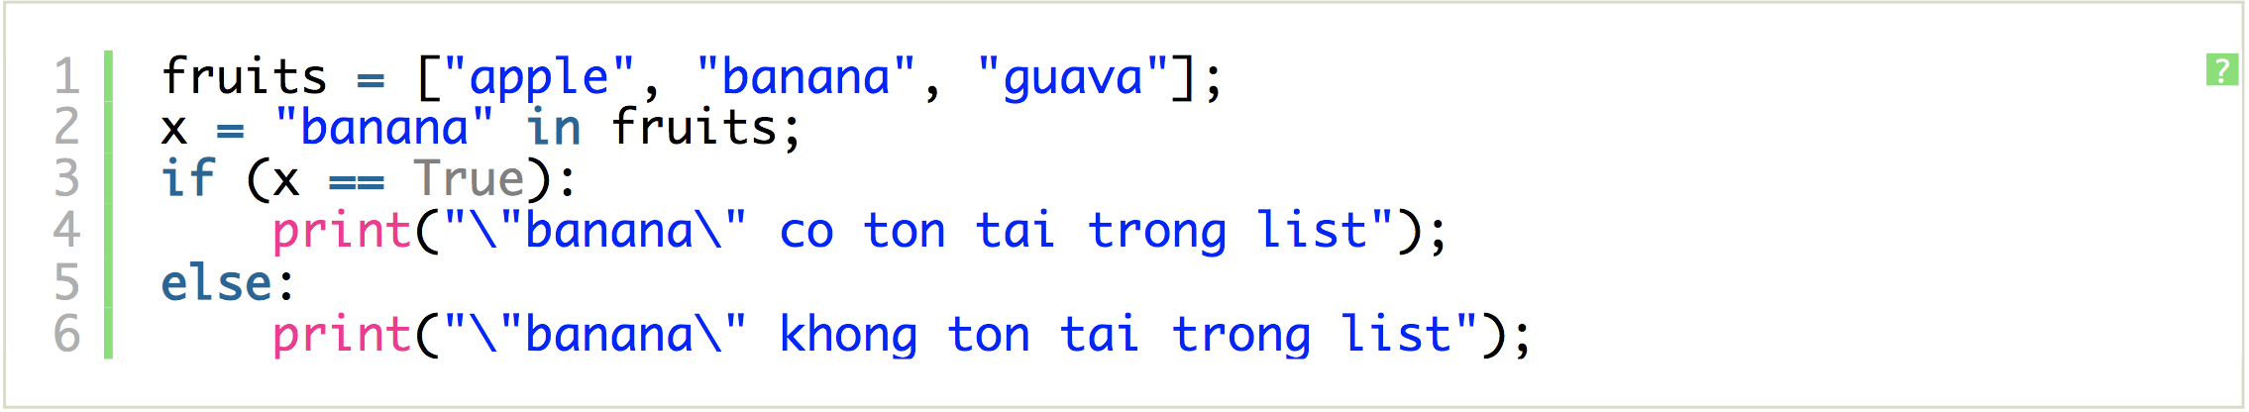
The list Class
Python Data Structures

Slide 9
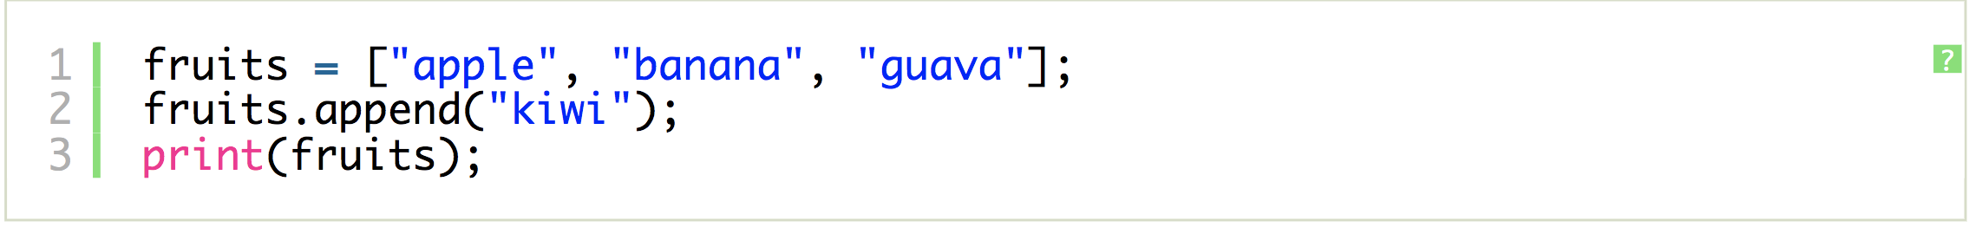
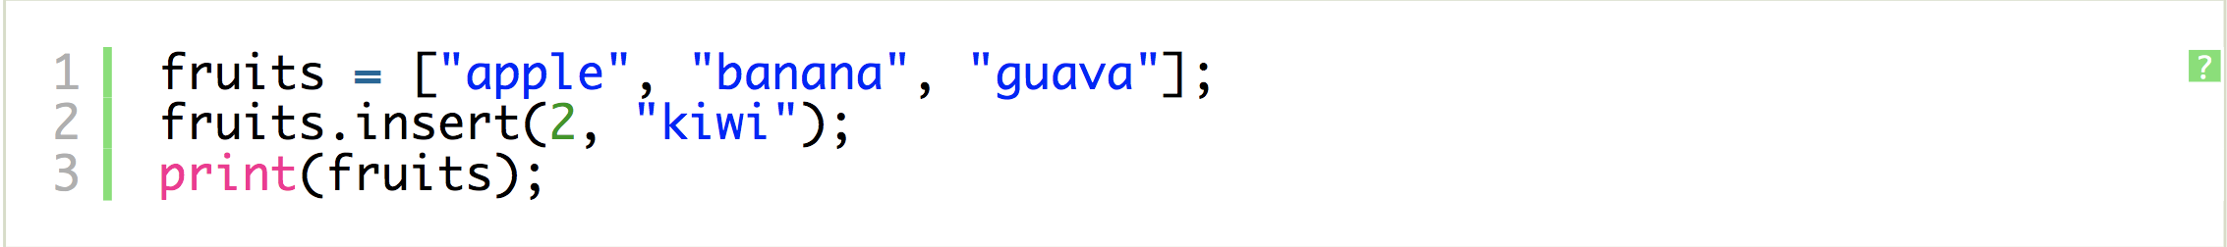
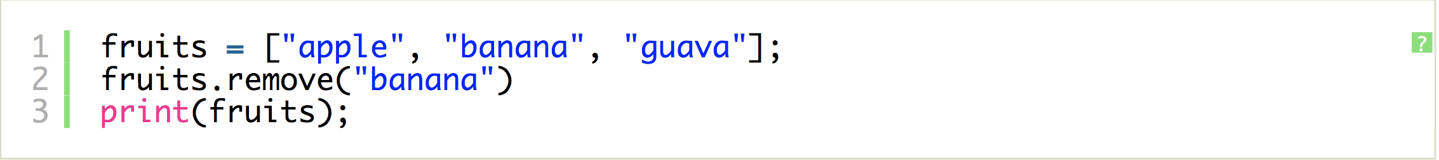
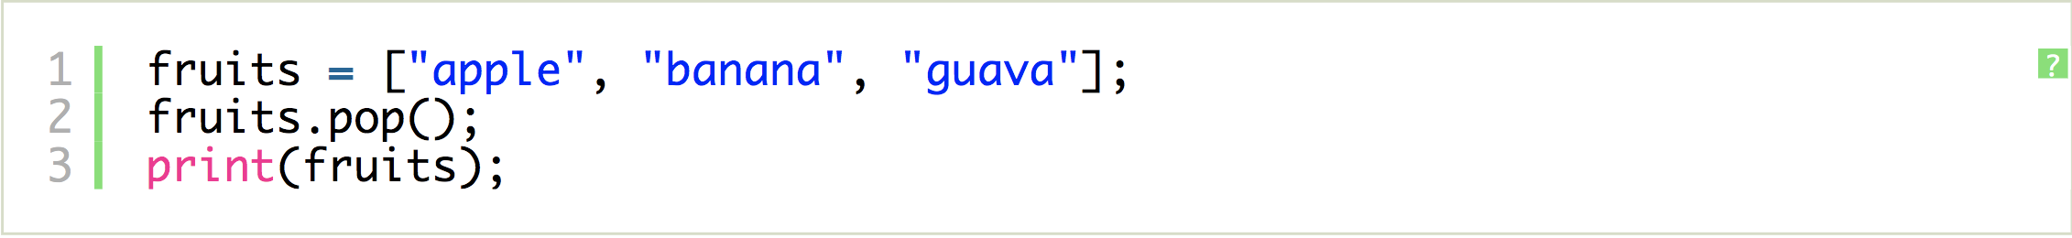
The list Class
Python Data Structures

Slide 10
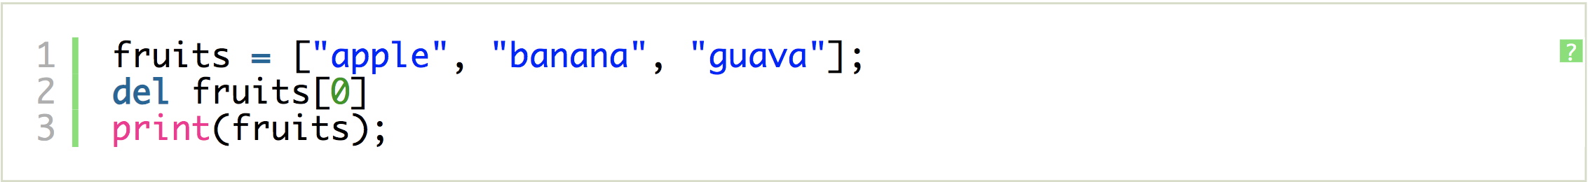
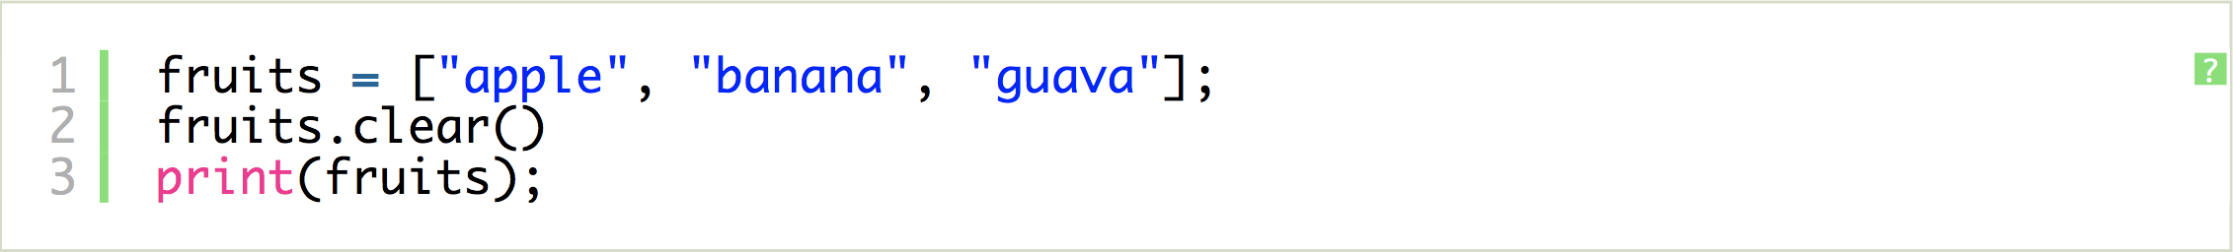
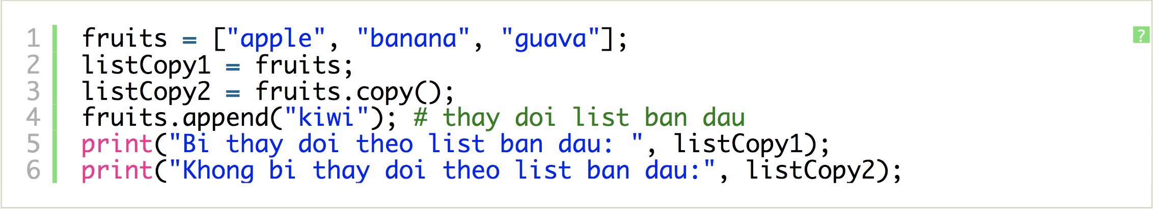
The list Class
Python Data Structures

Slide 11
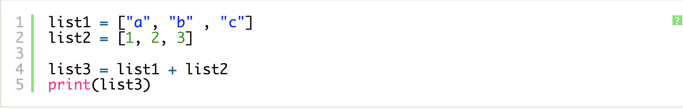
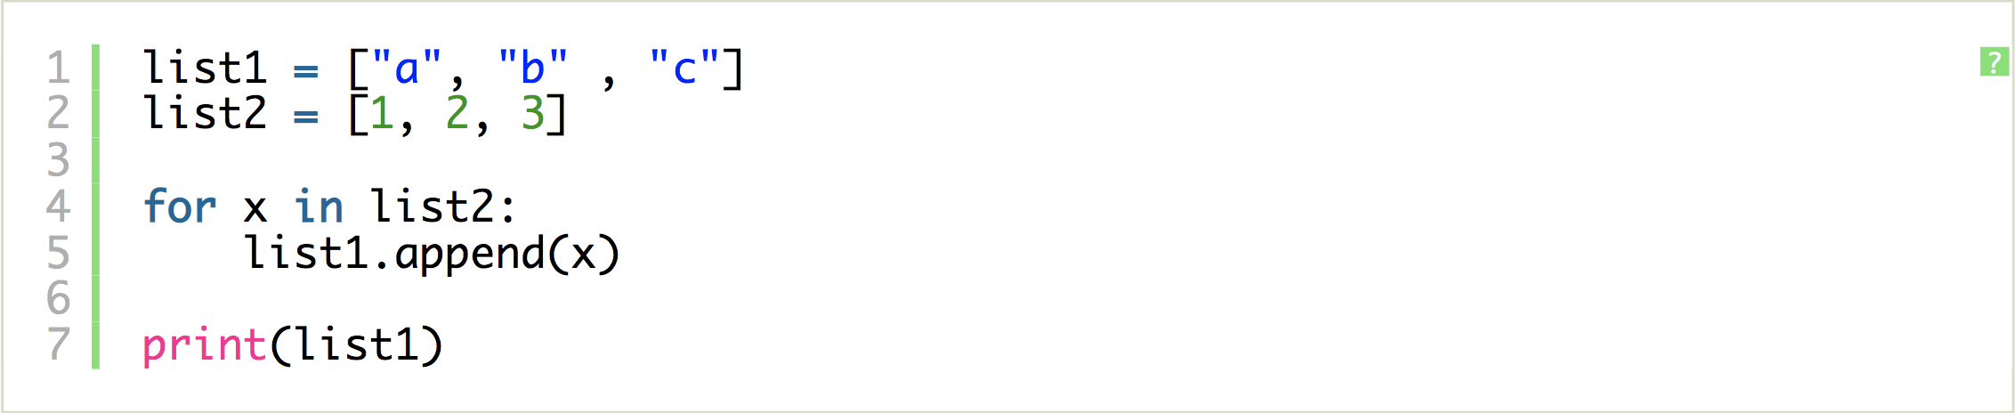
The list Class
Python Data Structures

Slide 12
The tuple Class
The tuple class provides an immutable (unchangeable) version of a sequence, which allows instances to have an internal representation that may be more streamlined than that of a list. Parentheses delimit a tuple.
  The empty tuple is ()
To express a tuple of length one as a literal, a comma must be placed after the element, but within the parentheses.
  For example, (17,) is a one-element tuple.
Python Data Structures

Slide 13
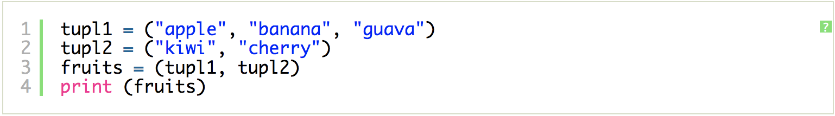
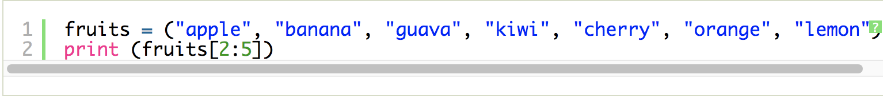
The tuple Class
Python Data Structures

Slide 14
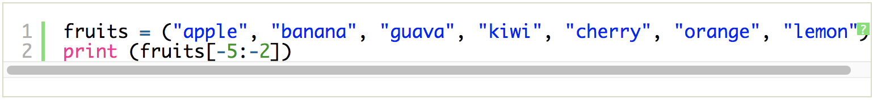
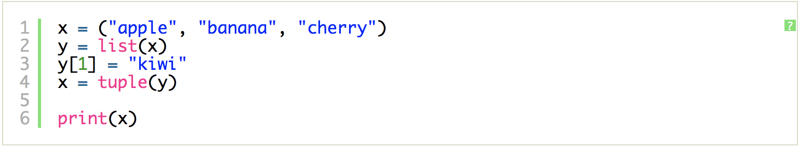

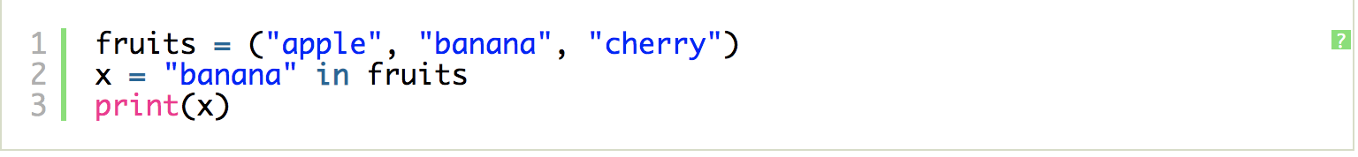
The tuple Class
Python Data Structures

Slide 15
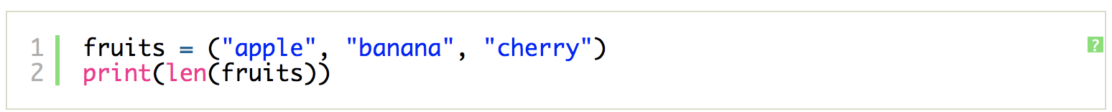
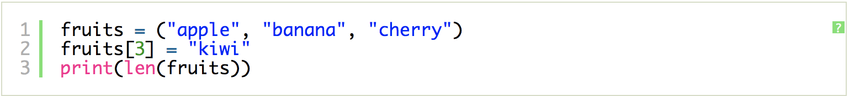
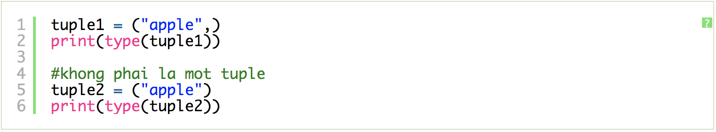
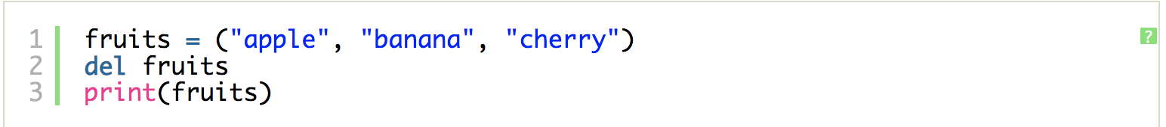
The tuple Class
Python Data Structures

Slide 16
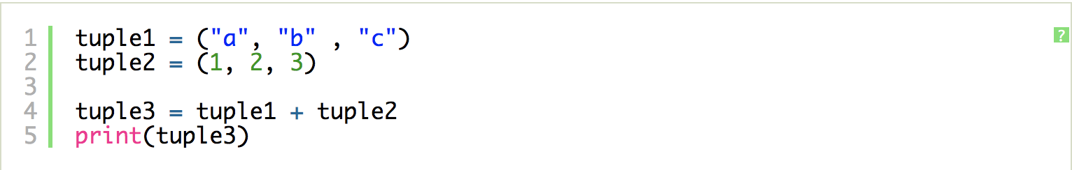
The tuple Class
Python Data Structures

Slide 17
Summary
Describe and manipulate tuple combinations and list data structures.
Execute basic tuple operations in Python.
Perform list operations in Python.
Some demonstration of using list and tuple
Python Data Structures

Slide 18
Q & A
Python Data Structures

